Slide 1


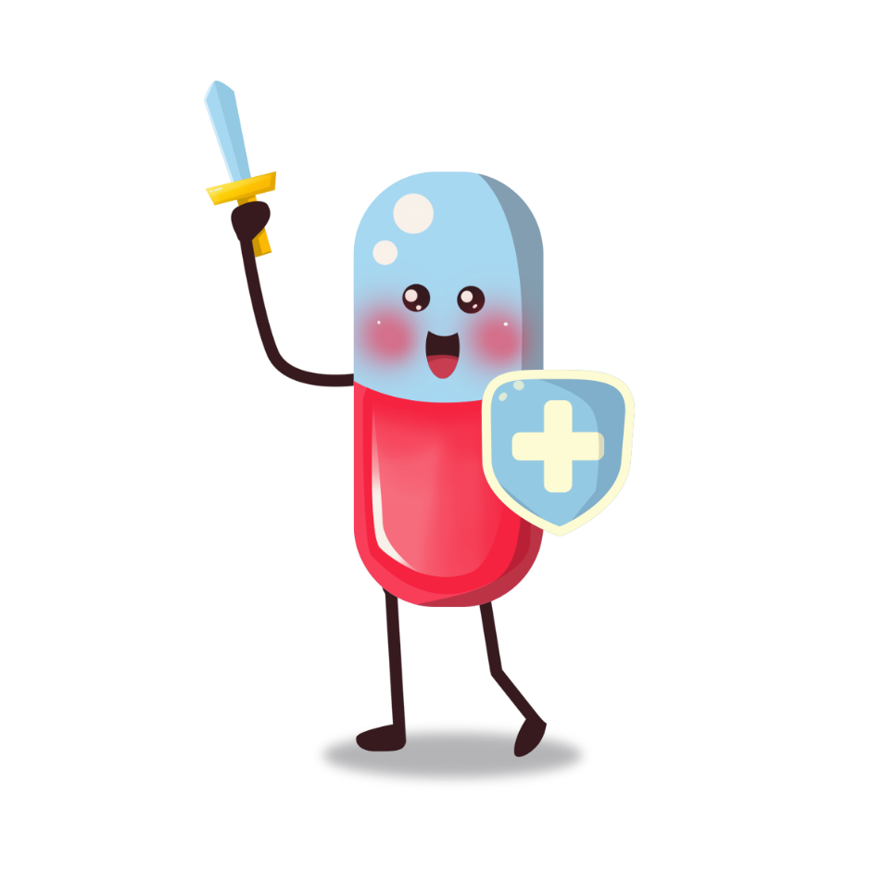

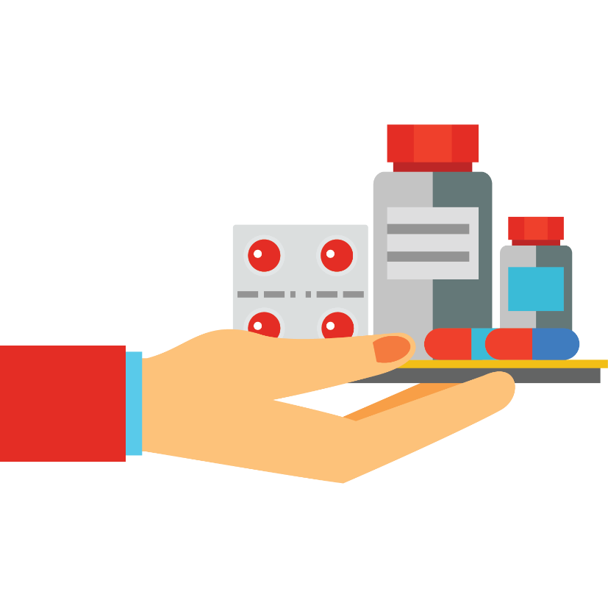

Slide 2
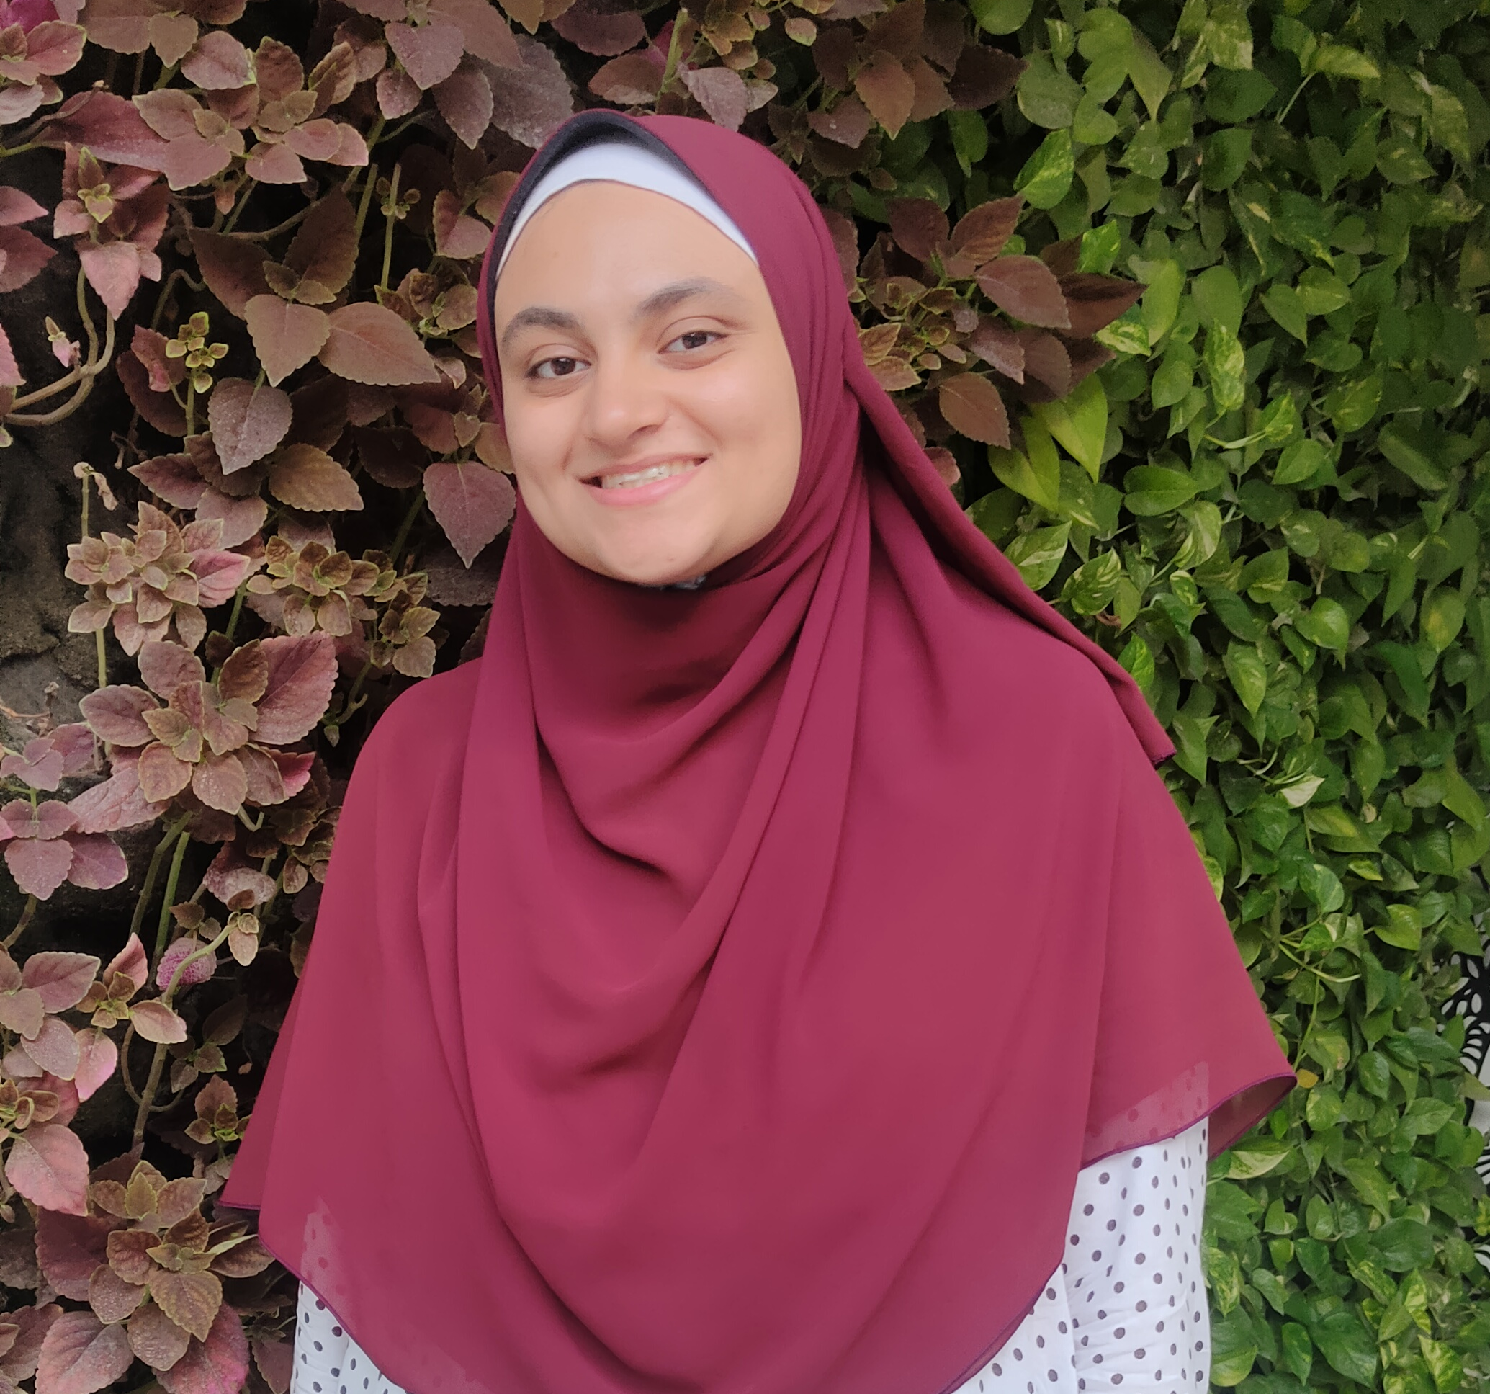


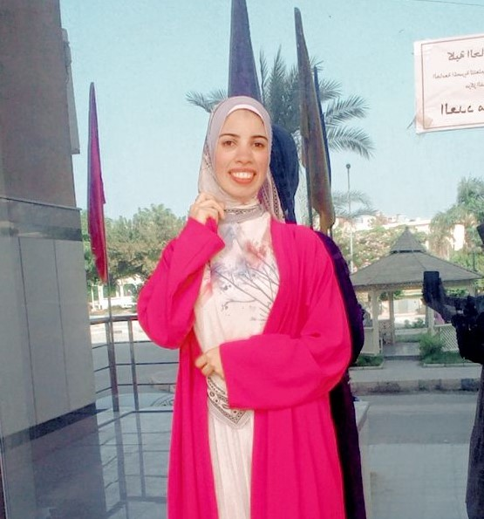
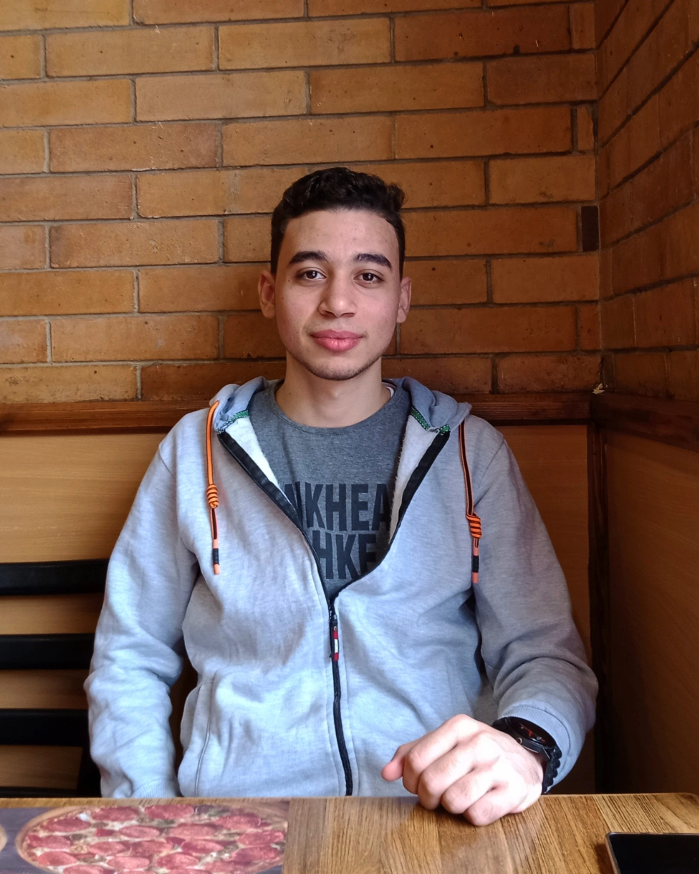
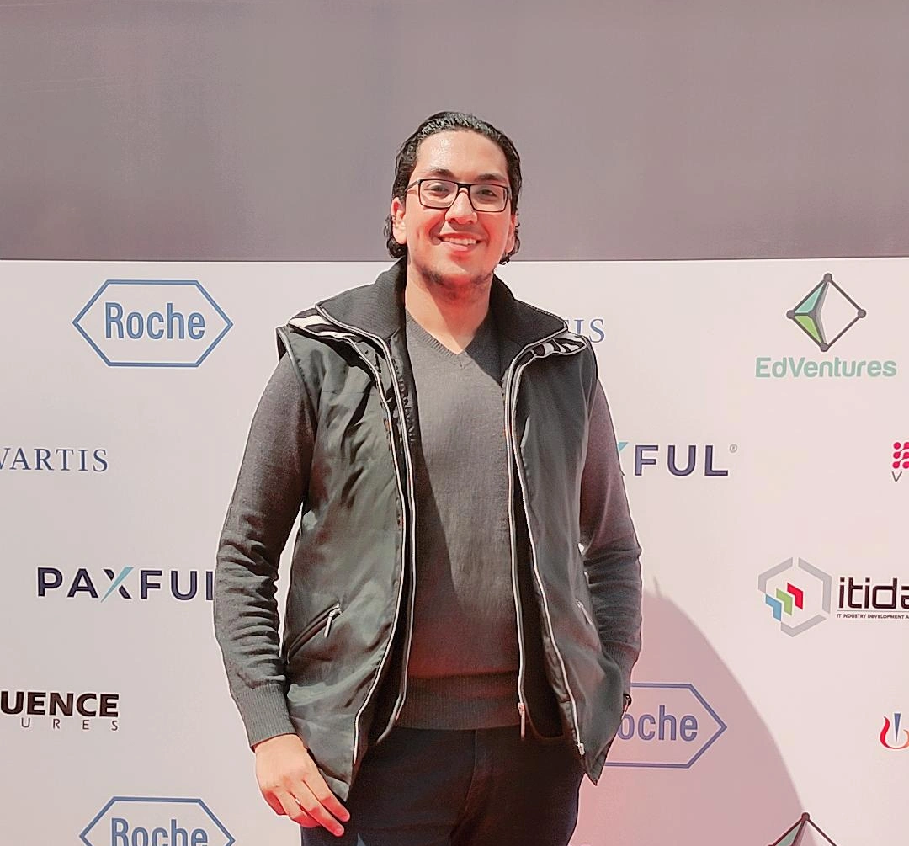


Our Team
Nada Hamdy
Noha Mohamed
Rehab Mohamed
Rehab Hassan
Nader Erian
Ahmed Alhoseny
Amir Gergeos

Slide 3
Problem Definition
01
Project Objectives
02
Related Work
03
Agenda
Proposed system
04
Diagrams
05
Implementaion
06
Conclusion & Future Work
07

Slide 4
Problem Definition
01
Project Objectives
02
Related Work
03
Agenda
Proposed system
04
Diagrams
05
Implementaion
06
Conclusion & Future Work
07

Slide 5
Problem Definition
01
Project Objectives
02
Related Work
03
Agenda
Proposed system
04
Diagrams
05
Implementaion
06
Conclusion & Future Work
07

Slide 6
Problem Definition
01
Project Objectives
02
Related Work
03
Agenda
Proposed system
04
Diagrams
05
Implementaion
06
Conclusion & Future Work
07

Slide 7
Problem Definition
01
Project Objectives
02
Related Work
03
Agenda
Proposed system
04
Diagrams
05
Implementaion
06
Conclusion & Future Work
07

Slide 8
Problem Definition
01
Project Objectives
02
Related Work
03
Agenda
Proposed system
04
Diagrams
05
Implementaion
06
Conclusion & Future Work
07

Slide 9
Problem Definition
01
Project Objectives
02
Related Work
03
Agenda
Proposed system
04
Diagrams
05
Implementaion
06
Conclusion & Future Work
07

Slide 10
Problem Definition
01
Project Objectives
02
Related Work
03
Agenda
Proposed system
04
Diagrams
05
Implementaion
06
Conclusion & Future Work
07

Slide 11
Problem Definition
01
Project Objectives
02
Related Work
03
Agenda
Proposed system
04
Diagrams
05
Implementaion
06
Conclusion & Future Work
07

Slide 12

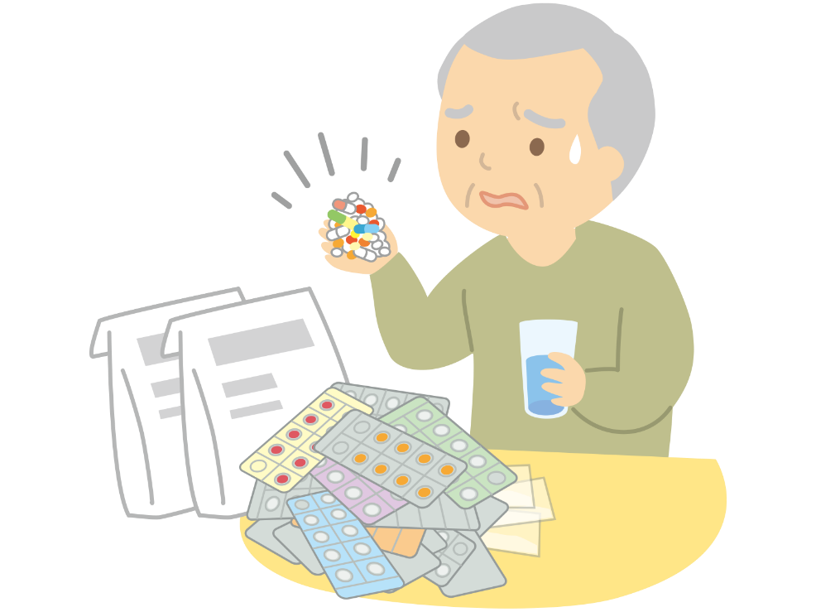
Problem Definition
01
Managing medications is challenging for patients due to the need to remember schedules and understand interactions between different drugs.
This complexity increases when multiple drugs are involved.

Slide 13

Project Objectives
02
Storing and managing patient drugs, especially the elderly and those who have a strict medication regimen.
Allow the person responsible for the patient to supervise the patient's health care.
Help the patient avoid any DDI.
Help the patient know about other drug alternatives.

Slide 14


Related Work
03
Medisafe App
MyTherapy
Advantages:
Advantages:
Medication Management
Family Tracking
More than one person can track the same patient
Measurement Trackers
Drug Interactions
Refill Reminders
Appointment Reminders
Condition Resources
Ad-free
Award-winning
Pill reminder and medication tracker
Mood tracker
Has health journal
Translated into 30 languages
Disadvantages:
Disadvantages:
Too expensive for premium version
Has more features but only for premium version

Slide 15

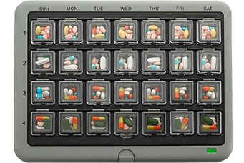
Related Work
03
MedMinder
Medication management tool that helps ensure you never forget to take your medications.
It provides notifications for refills and has a pill reminder alarm.
It also allows you to record all your medicines and the recommended dosage.
The app has a feature called “Med-Friend” that notifies a friend or family member in case you forget to take your medication.
It can synchronize all the family members’ medicine pillboxes in one place.

Slide 16
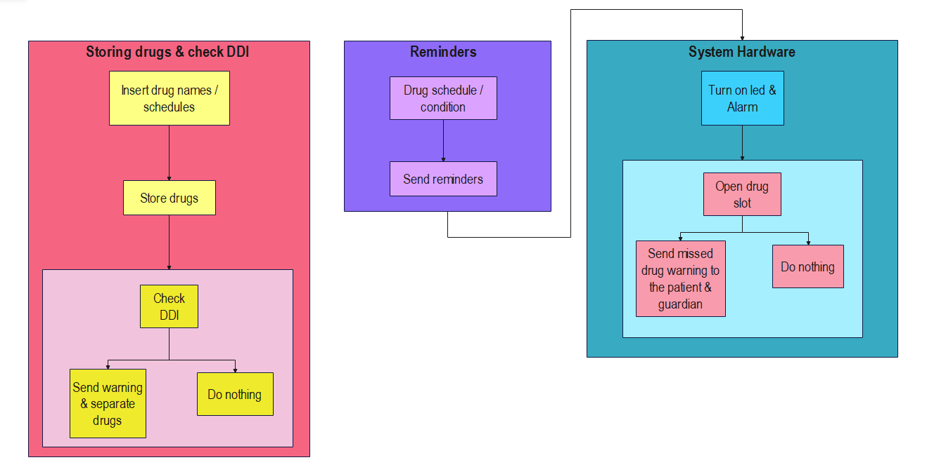
Proposed system
04

Slide 17
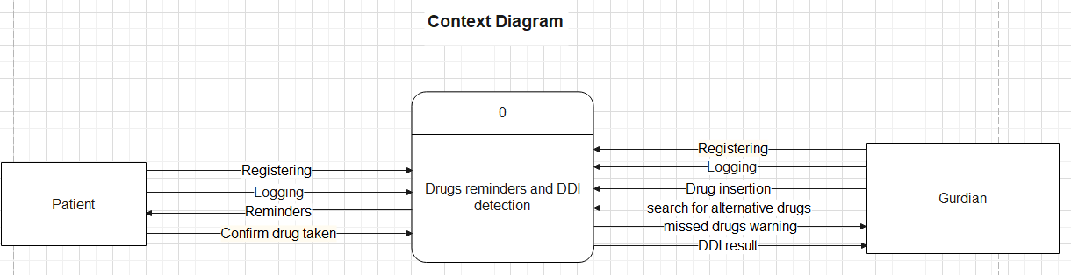
Diagrams
05
Context Diagram

Slide 18
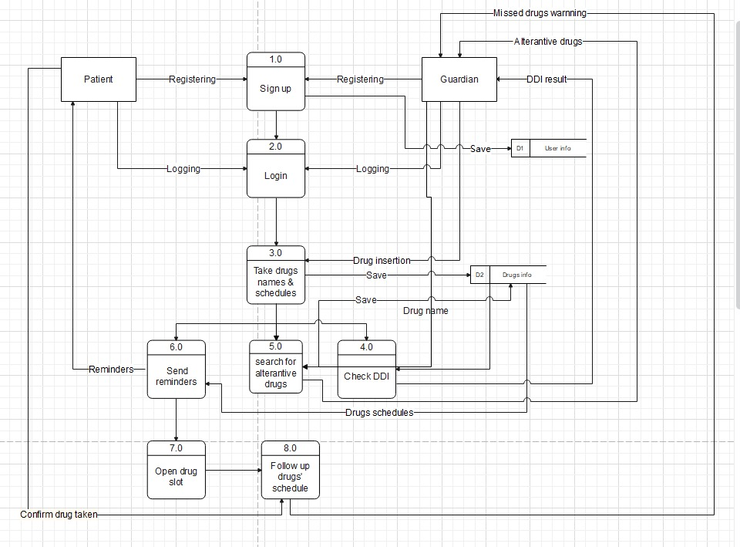
Diagrams
05
Data Flow Diagram

Slide 19
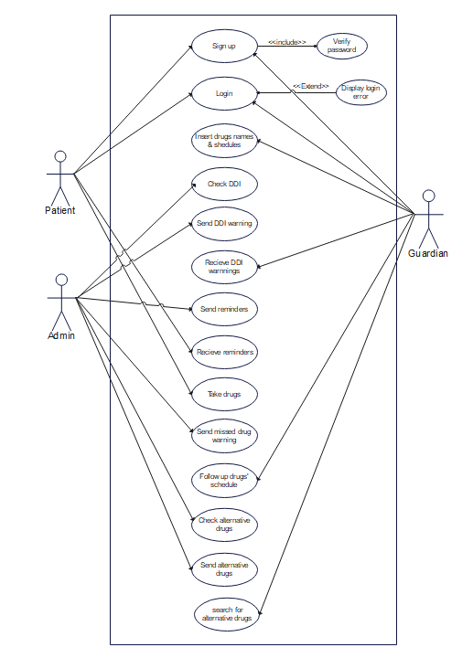
Diagrams
05
Use Case Diagram

Slide 20
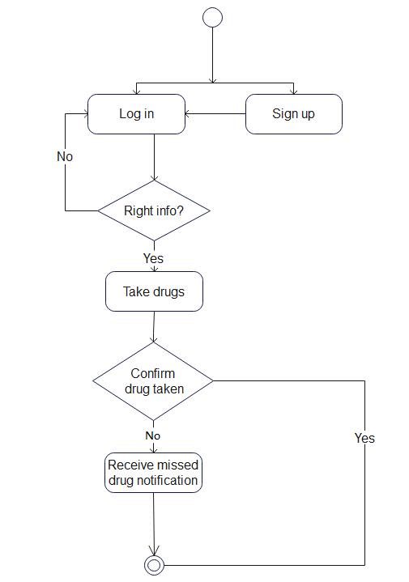
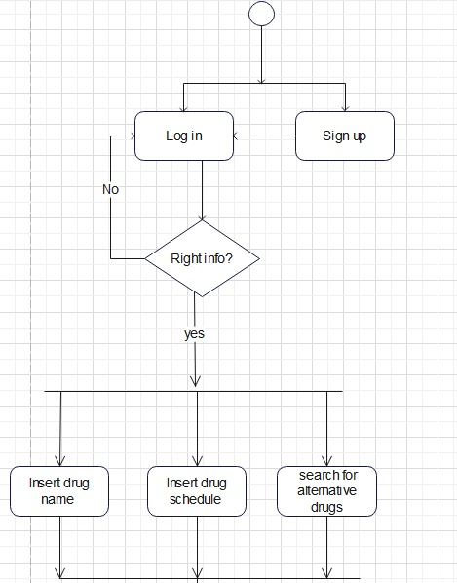
Diagrams
05
Activity Diagram

Slide 21
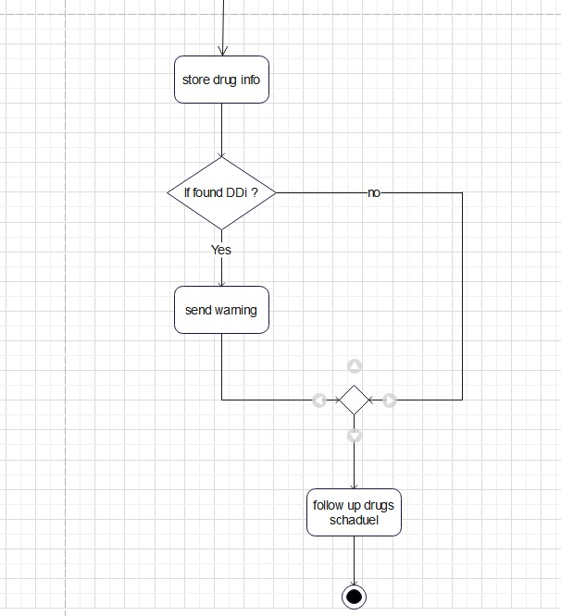
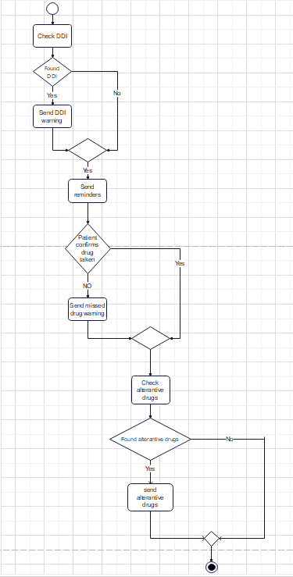
Diagrams
05
Activity Diagram

Slide 22
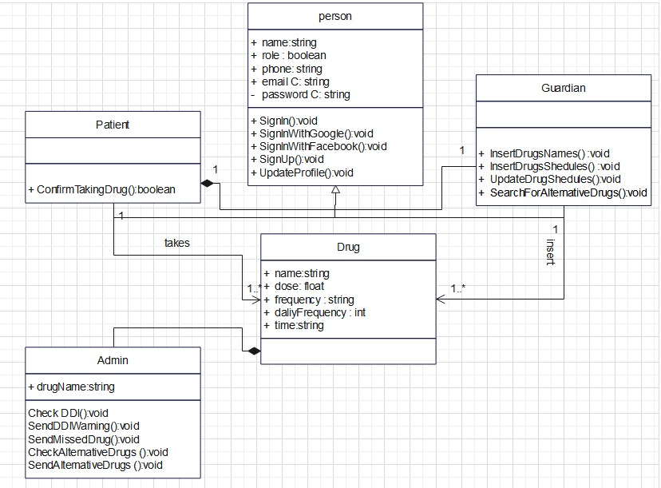
Diagrams
05
Class Diagram

Slide 23
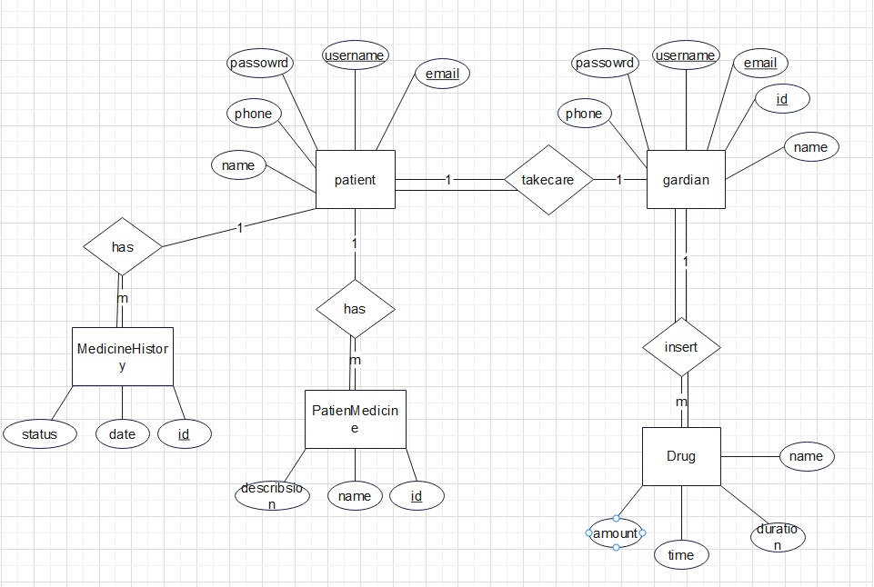
Diagrams
05
Relational Database Diagram (ERD)

Slide 24

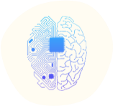
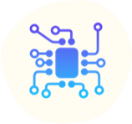
Implementaion
06
FLUTTER
Machine Learning
Embedded System

Slide 25

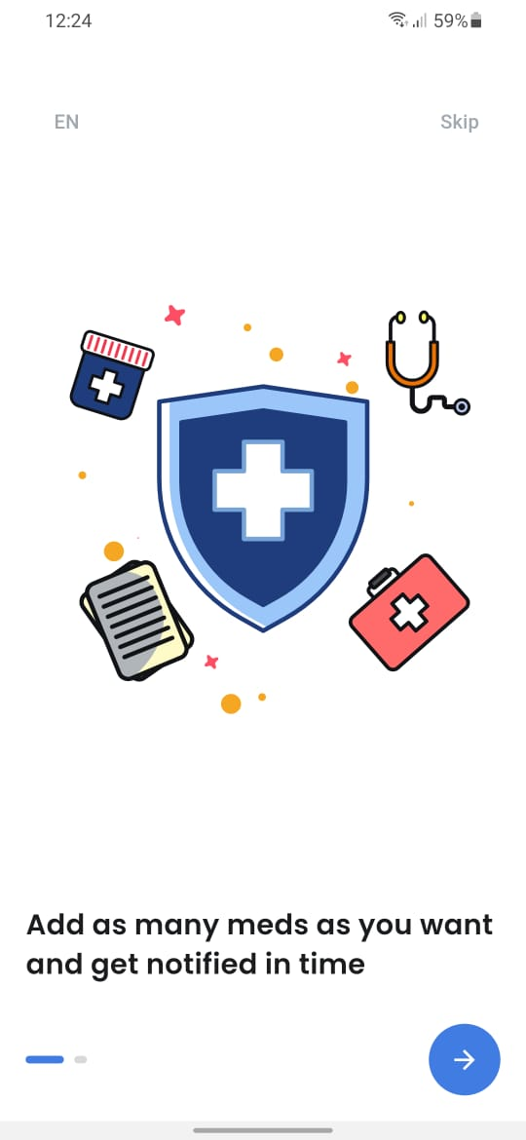
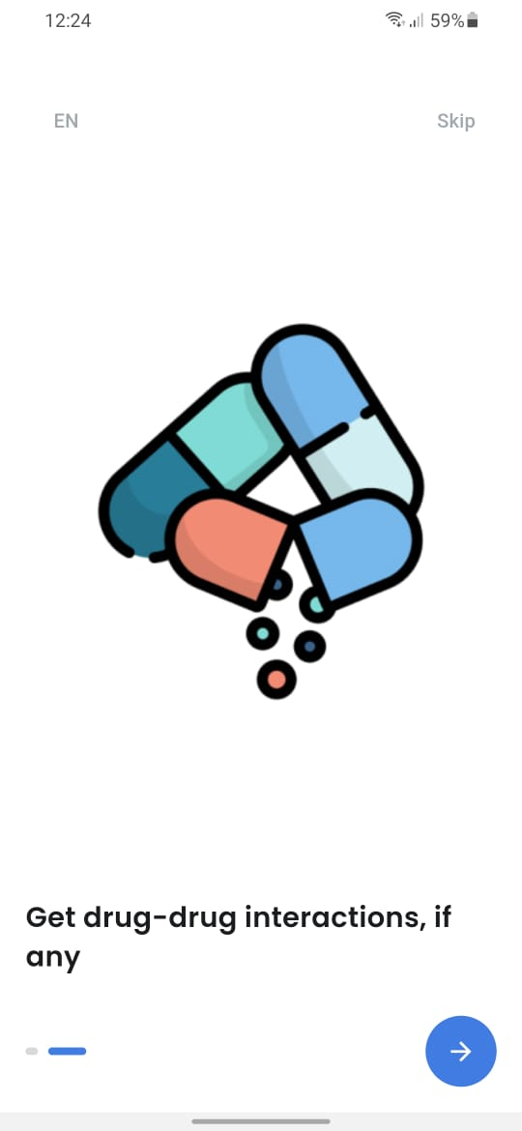
Implementaion
06
FLUTTER

Slide 26
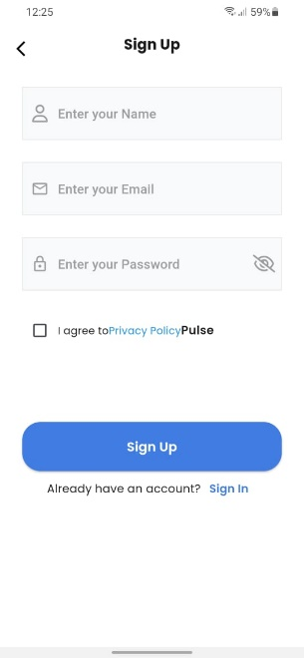
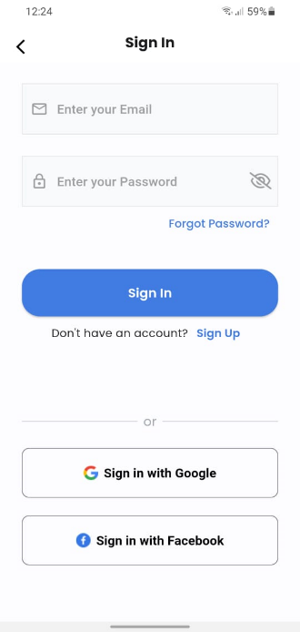
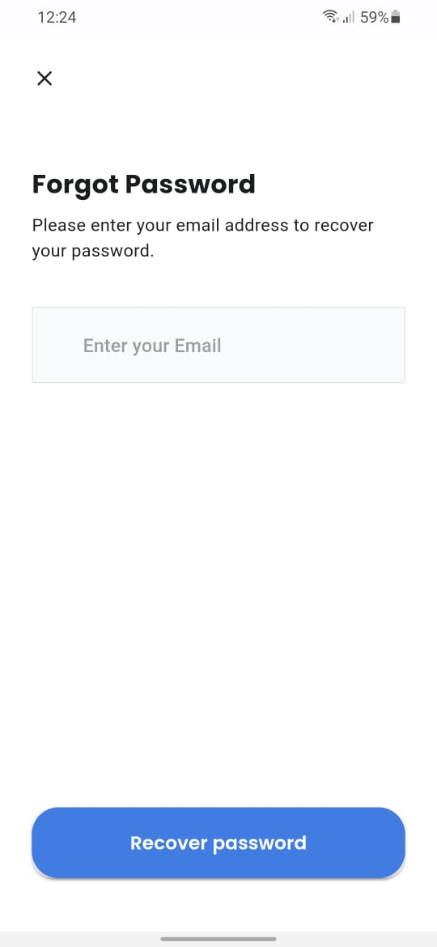
Implementaion
06
FLUTTER

Slide 27
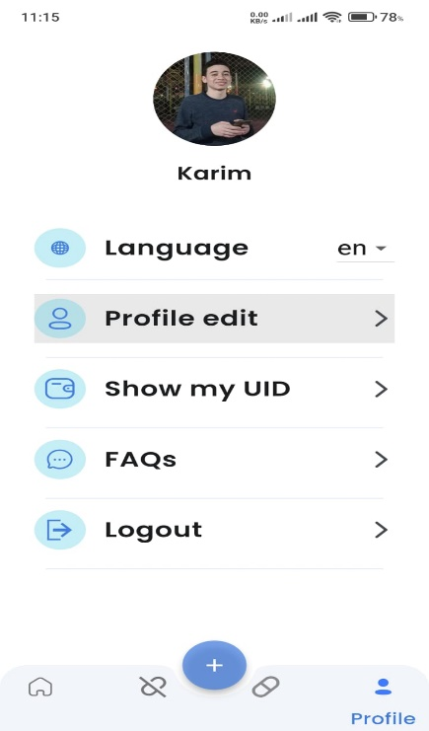
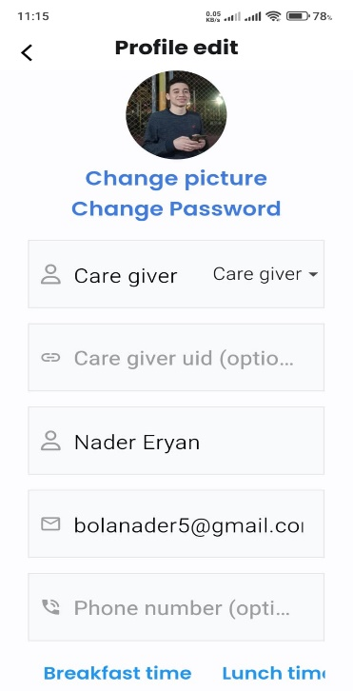
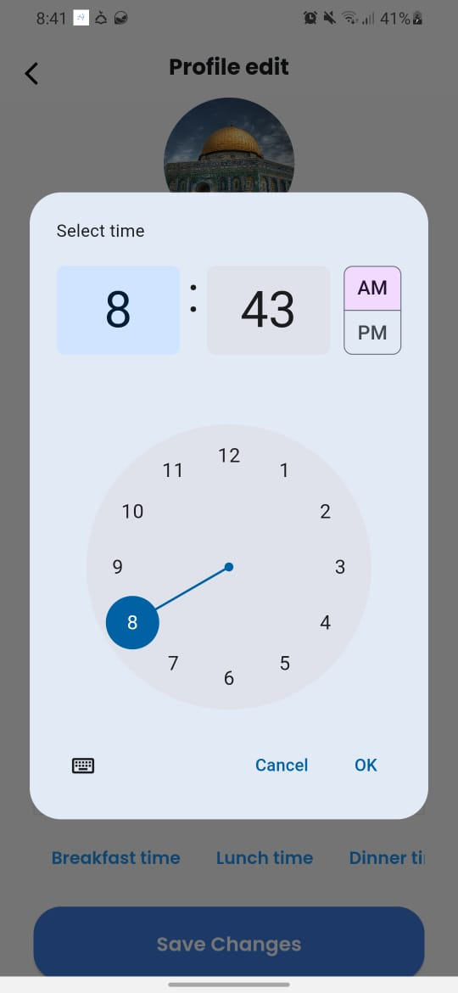
Implementaion
06
FLUTTER

Slide 28
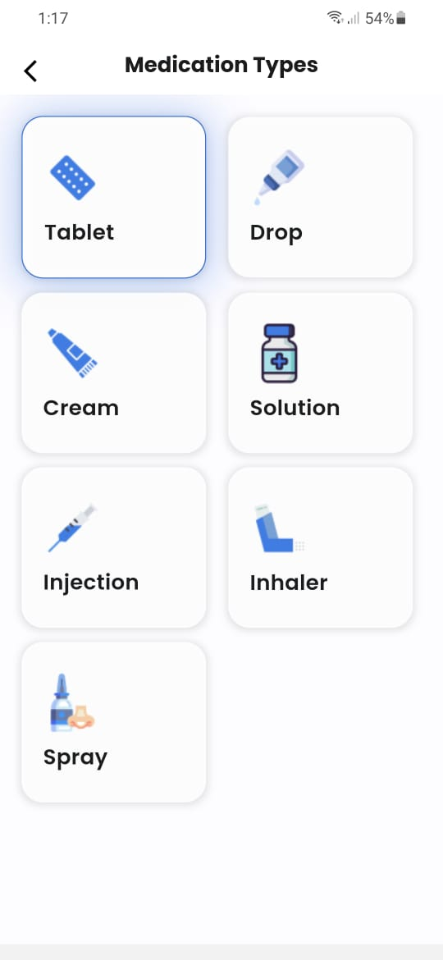
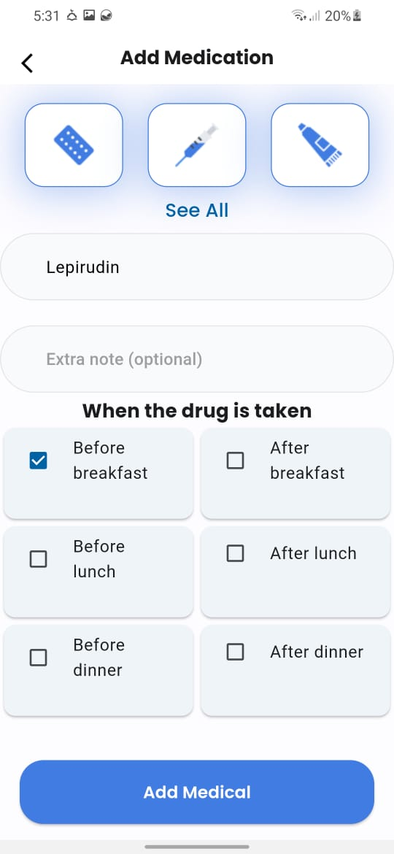
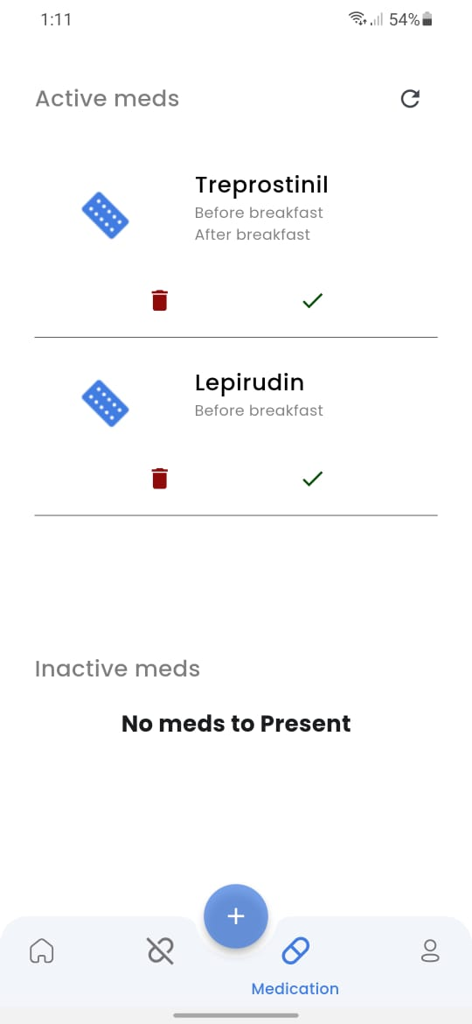
Implementaion
06
FLUTTER

Slide 29
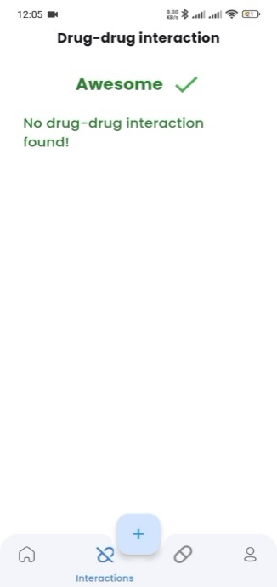
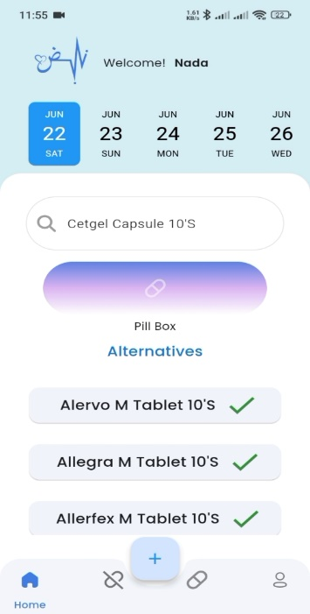
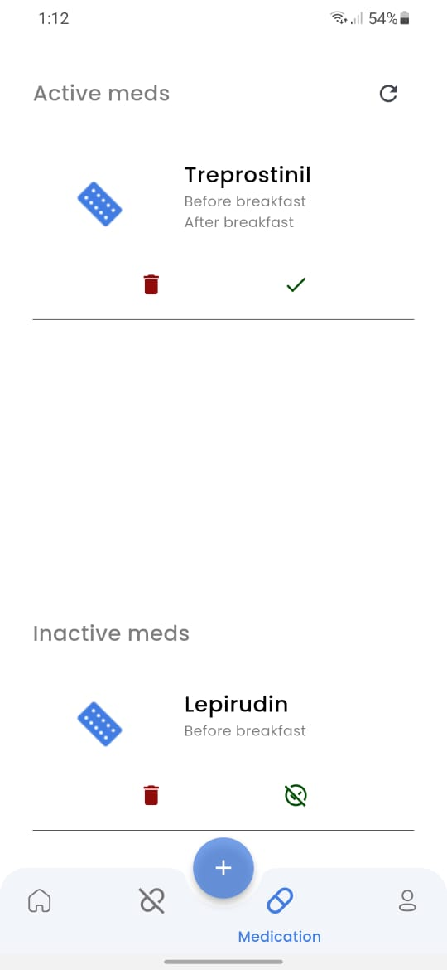
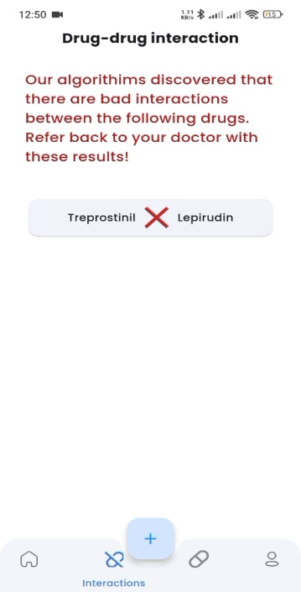
Implementaion
06
FLUTTER

Slide 30
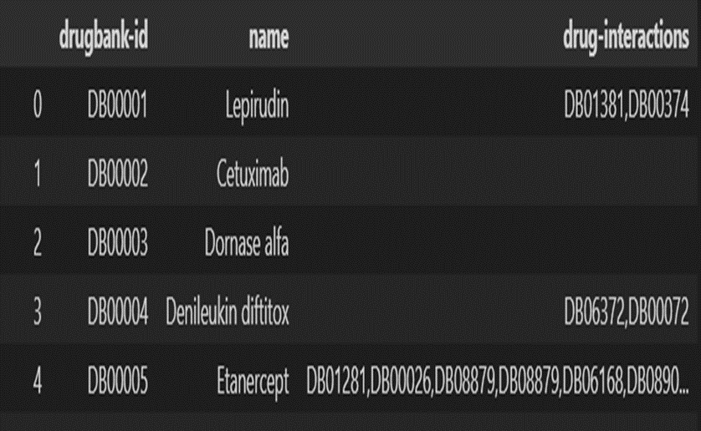
Implementaion
06
Check Drug Interactions
Load the data from the Excel file
Ask user for drug names
Find DrugBank IDs for user-entered drugs

Slide 31
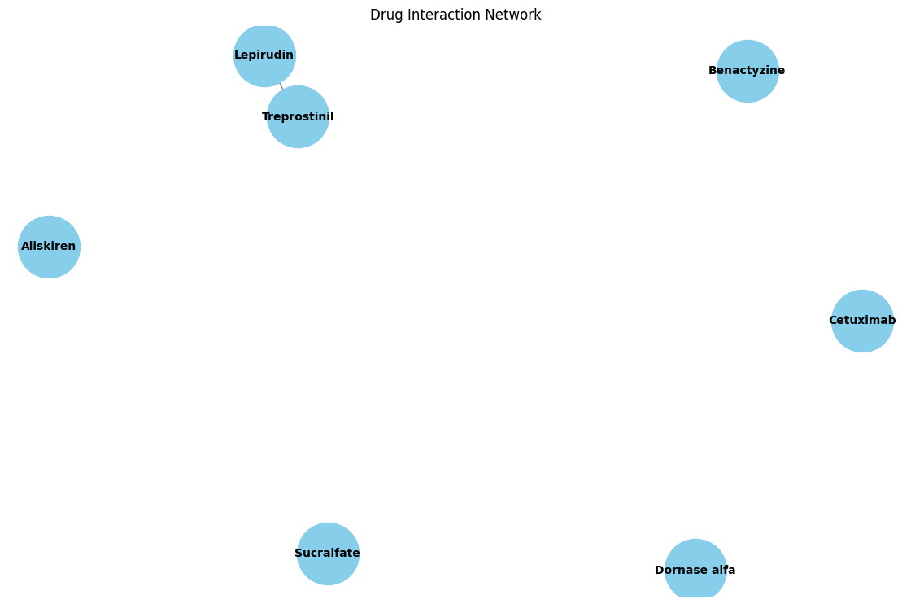
Implementaion
06
Check Drug Interactions
Check for interactions between user-entered drugs by DrugBank ID
Plot the drug interaction network
Drug Interaction Network Analysis

Slide 32
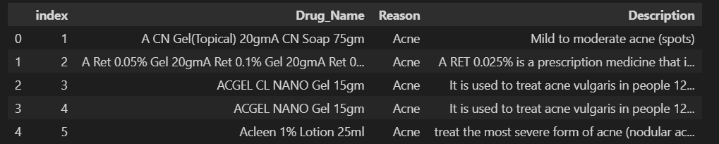
Implementaion
06
Machine Learning
Introduction to Medicine Recommendation System
Key Points:
Overview: Explain the goal of the system - recommending similar medicines based on their descriptions and reasons for use.
Dataset: Mention the dataset used (medicine.csv) and its key columns (Drug_Name, Description, Reason).Slide

Slide 33
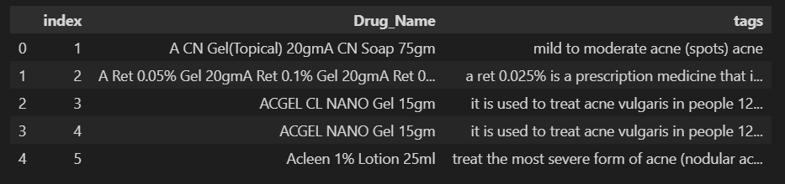
Implementaion
06
Machine Learning
Data Preprocessing
Key Points:
Loading and Cleaning Data: Loading dataset, checking for missing values, and removing duplicates.
Text Processing: Combining 'Description' and 'Reason', converting text to lowercase, and stemming words.

Slide 34
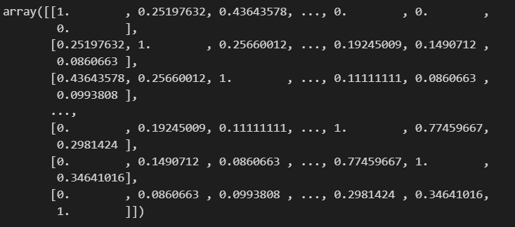
Implementaion
06
Machine Learning
Feature Extraction and Similarity Calculation
Key Points:
Count Vectorizer: Converting text data into numerical feature vectors.
Cosine Similarity: Calculating similarity between vectors to find similar medicines.

Slide 35
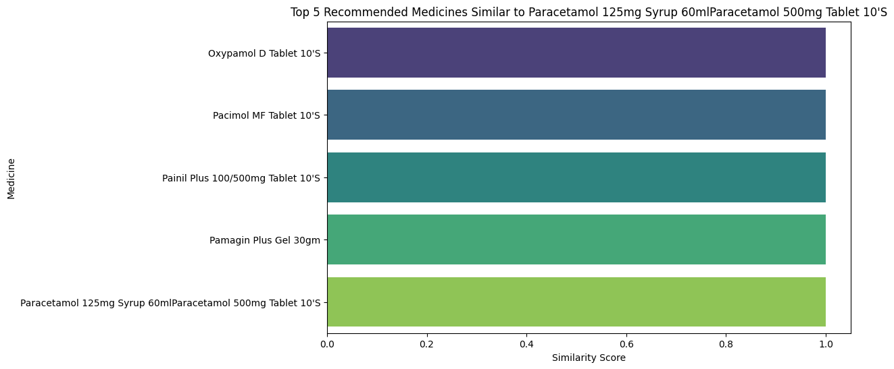
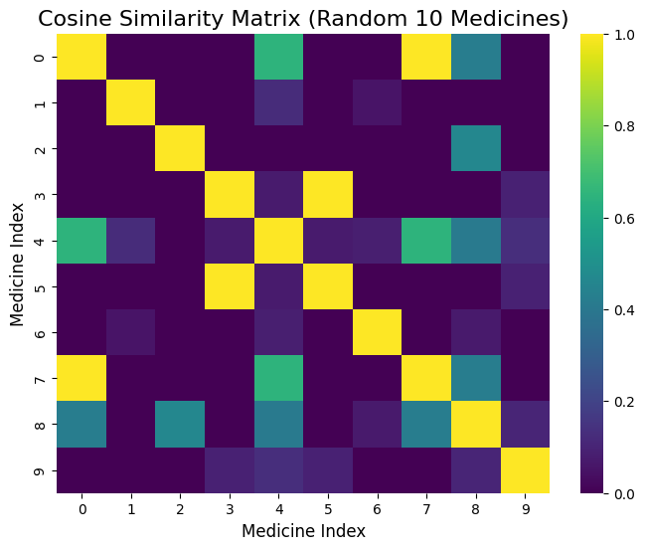
Implementaion
06
Machine Learning
Medicine Recommendation and Visualization
Key Points:
Recommendation Function: Finding similar medicines based on cosine similarity.
Visualization: Using bar plots to visualize recommended medicines.
Top 5 Recommended Medicines Similar
Cosine Similarity Matrix

Slide 36
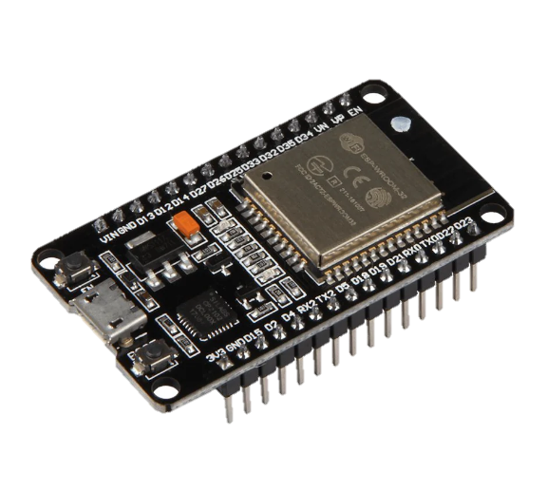
Implementaion
06
Embedded System
ESP32

Slide 37
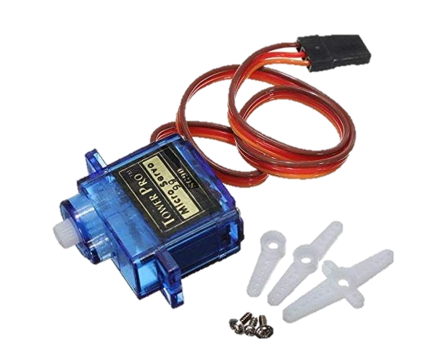
Implementaion
06
Embedded System
Servo Motor

Slide 38

Implementaion
06
Embedded System
Buzzer

Slide 39
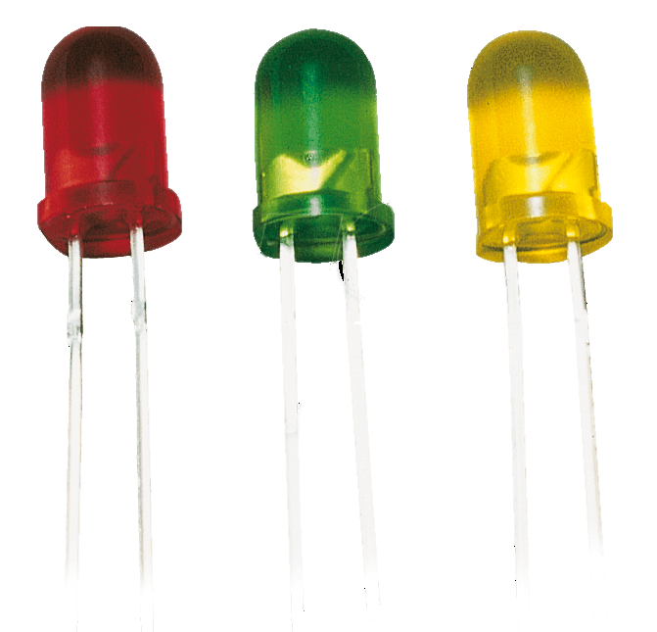
Implementaion
06
Embedded System
LEDs

Slide 40
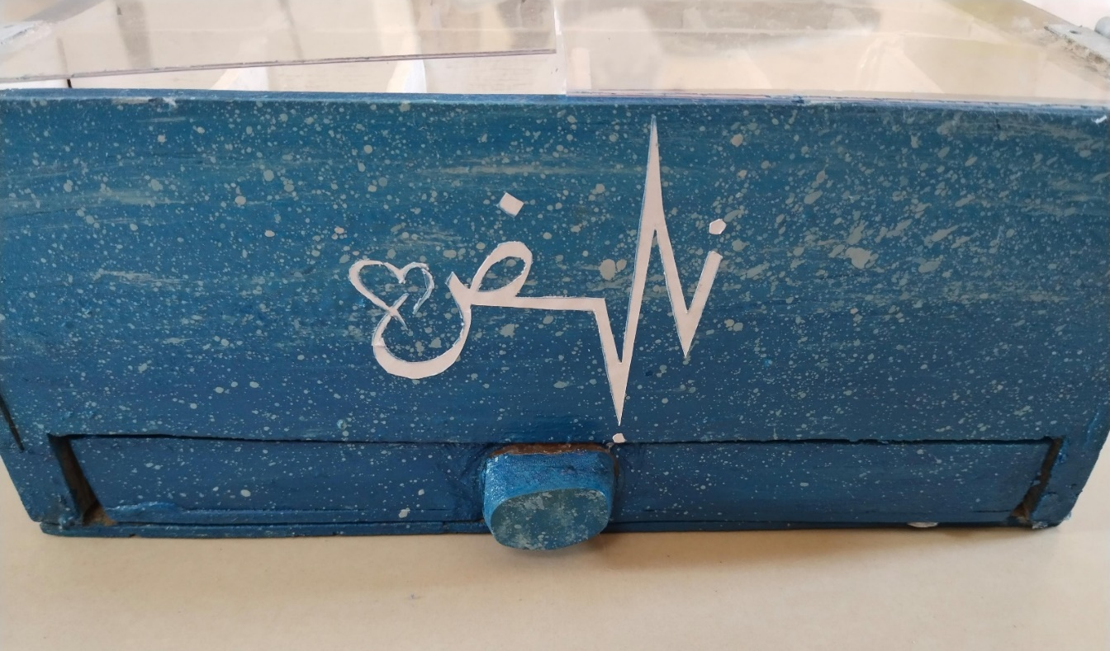
Implementaion
06
Embedded System
Box

Slide 41
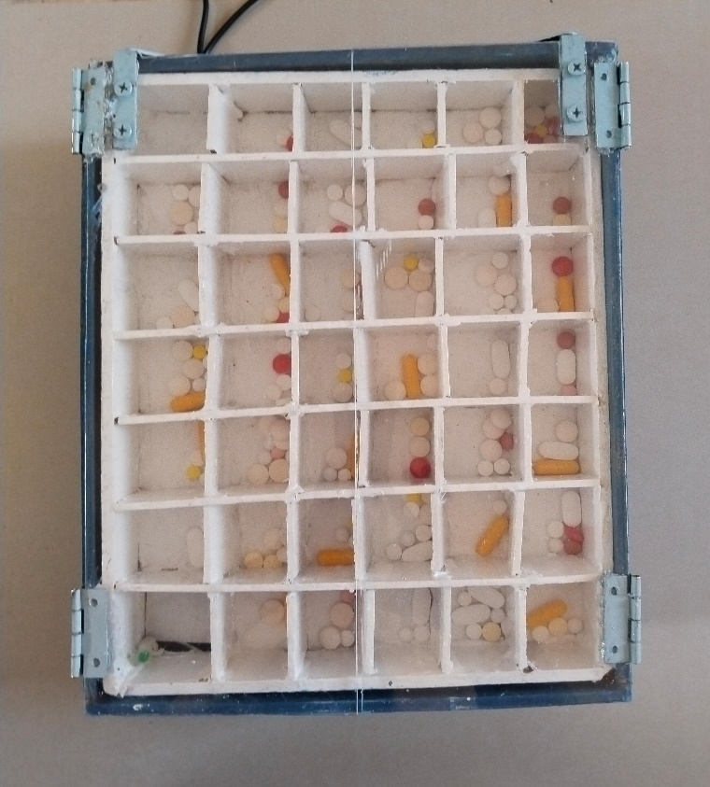
Implementaion
06
Embedded System
Box

Slide 42
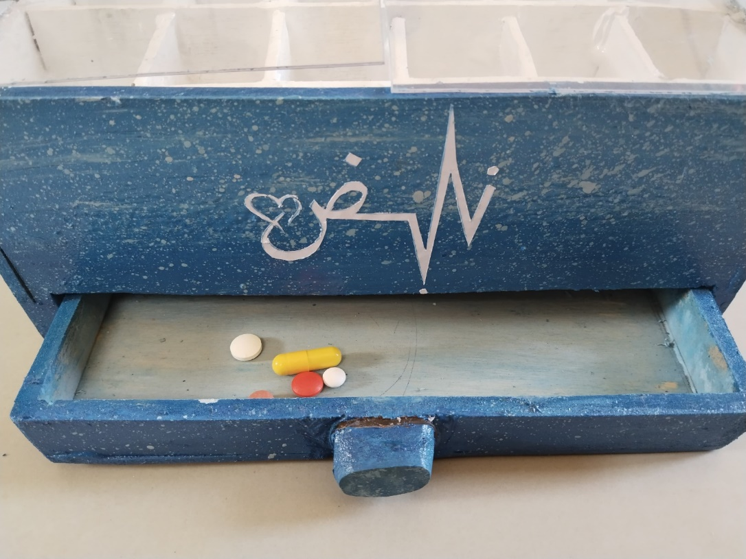
Implementaion
06
Embedded System
Box

Slide 43
Conclusion & Future Work
07
Conclusions
In conclusion, the development of the “Pulse” medication management application has been driven by the necessity to assist patients, particularly those with chronic conditions or cognitive impairments, in managing their medications effectively and safely. The application combines a user-friendly interface, a robust architecture using Flutter and Dart, and an AI model to ensure drug safety and interaction checks.
The physical pill dispenser adds an additional layer of convenience and adherence by dispensing the correct medication at the right time. The integration of features such as reminders, allergy tracking, and caregiver supervision ensures comprehensive support for patients, reducing the burden on caregivers and enhancing the overall healthcare experience

Slide 44
Conclusion & Future Work
07
Future Work
For future work we aim to:
Integration with doctors and Pharmacies
Patient and Caregiver Education to inform them about the importance of medication adherence, potential side effects, and lifestyle choices that can impact health.
Increase amount of dataset used to cover all possible drugs.
We will keep each type of drugs in the same slot, and when the caregiver enters the drugs and its dates, we will collect the quantity of the drugs at the appropriate time and give it to the patient.

Slide 45
THANK YOU

